Slide 1
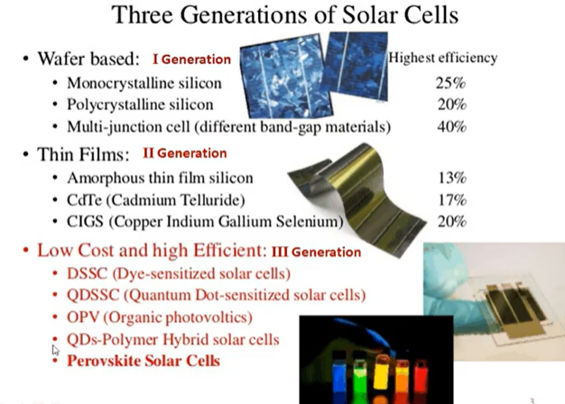
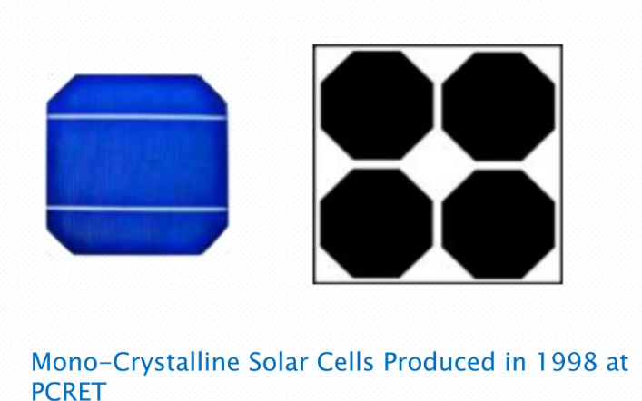
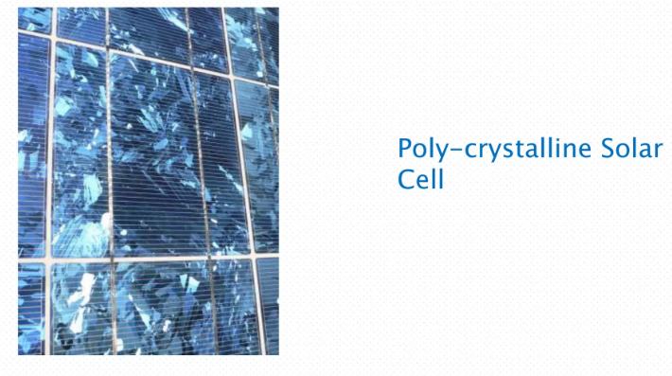
COMMERCIAL SOLAR CELLS

Slide 2
MONO CRYSTALLINE SOLAR CELL
These cells are made from pure monocrystalline silicon.
In these cells, the silicon has a single continuous crystal lattice structure with almost no defects or impurities.
The main advantage of monocrystalline cells is their high efficiency, which is typically around 15%.
Monocrystalline solar cells give a more aesthetic and premium look.
They typically have a black hue. Each corner of the cell is clipped, giving them an octagonal shape.
The disadvantage of these cells is that a complicated manufacturing process is required to produce monocrystalline silicon, which results in slightly higher costs than those of other technologies.

Slide 3
POLY CRYSTTALINE SOLAR CELL
Unlike monocrystalline, polycrystalline silicon is composed of several small crystallites.
It is a non-homogeneous material and shows a discontinuity in electrical, thermal, and crystal properties.
Because of defects in the crystal structure, poly c-Si solar cells are less efficient than mono c-Si cells. The highest lab-scale efficiency published is 22%, and in production, it falls to 18–20%.

Slide 4
THIN FILM SOLAR CELLS
Thin-film solar cell, type of device that is designed to convert light energy into electrical energy (through the photovoltaic effect) and is composed of micron-thick photon-absorbing material layers deposited over a flexible substrate.
Thin-film solar cells were originally introduced in the 1970s by researchers at the Institute of Energy Conversion at the University of Delaware in the United States.
The technology continuously improved so that in the early 21st century the global thin-film photovoltaic market was growing at an unprecedented rate and was forecast to continue to grow.

Slide 5
THIN FILM SOLAR CELLS
Several types of thin-film solar cells are widely used because of their relatively low cost and their efficiency in producing electricity. Thin-film solar cells are newer photovoltaic technology and consist of one or more thin films of photovoltaic materials on a substrate. Their primary advantage over traditional crystalline silicon cells is cost. They are cheaper. It holds less than 15% of the global market as of 2016.
Another advantage is flexibility. The thickness of the film is in nanometers. That makes thin-film PV cells pliable. However, we can manufacture rigid thin-film cells when the substrate used is rigid.
Three common thin-film solar cells are cadmium telluride (CdTe), copper indium gallium selenide (CIGS), and amorphous thin-film silicon (a-Si).

Slide 6
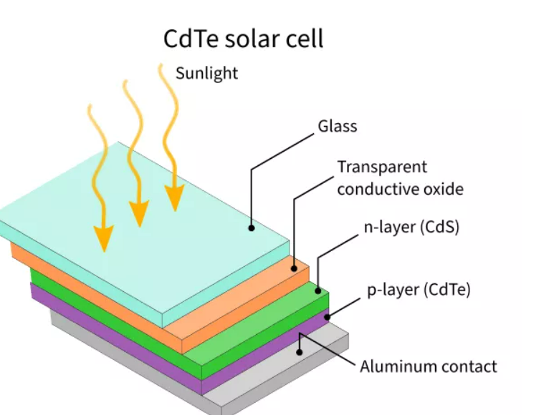
CADMIUM TELLURIDE SOLAR CELLS
Cadmium telluride (CdTe) solar cells use Cadmium telluride to absorb solar energy. They remain the most prominent thin-film cells because of a lower manufacturing cost and lower carbon footprint.
The toxicity of cadmium and scarcity of tellurium in the earth’s crust is another major problem that limits its acceptance. CdTe shares 5% of the total photovoltaic market.
These PV cells have an advantage of a low production cost compared to the convenient c-Si cell. But they are inefficient. The highest known lab efficiency is 22.1% by First Solar. This value falls to 16.1% on a commercial scale.

Slide 7
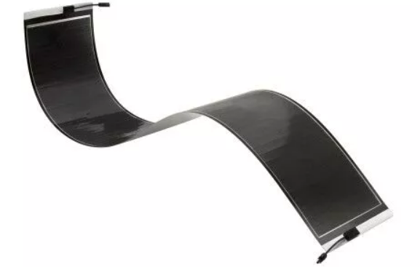
COPPER INDIUM GALLIUM SELENIDE SOLAR CELLS
Copper indium gallium selenide (CIGS) is another common thin-film photovoltaic cell.
The cell has high efficiency because of a high absorption coefficient of copper indium gallium selenide.
Even though the lab efficiency exceeds 20%, on a commercial-scale, it goes between 12 to 14%.

Slide 8
THIN FILM PV DEVICE FABRICATION
Thin film: thickness typically <1000nm.
Special properties of thin films: different from bulk materials, it may be –
Not fully dense - lower electrical conductivity than bulk metal.
Under stress
This happens because they grow on another surface, and both materials may expand or shrink differently.
Different defect structures from bulk
Many small defects such as tiny cracks, dislocations, or grain boundaries.
They can change electrical, mechanical, or optical behavior.
Quasi ‐ two dimensional (very thin films)
Because thin films are extremely thin, they behave almost like a 2-dimensional sheet.

Slide 9
THIN FILM DEPOSITION METHODS
Chemical Vapor Deposition (CVD)
Reactant gases introduced in the chamber; chemical reactions occur on wafer surface leading to the deposition of a solid film.
E.g. APCVD, LPCVD, PECVD, most commonly used for dielectrics and Si
Physical Vapor Deposition (PVD)
No chemical reaction involved
Vapors of constituent materials created inside the chamber, and condensation occurs on wafer surface leading to the deposition of a solid film.
E.g. evaporation, sputter deposition, most commonly used for metals.

Slide 10
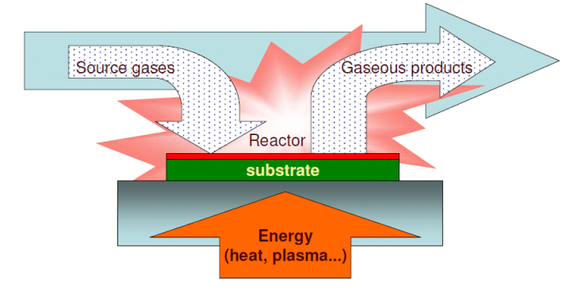
Chemical Vapor Deposition (CVD)
CVD : DEPOSIT FILM THROUGH CHEMICAL REACTION AND SURFACE ABSORPTION
CVD steps:
Introduce reactive gases to the chamber.
Activate gases (decomposition) by heat or plasma.
Gas absorption by substrate surface
Reaction take place on substrate surface, film firmed.
Transport of volatile byproducts away form substrate.
Exhaust waste.

Slide 11
CVD advantages and disadvantages
Advantages
Disadvantages
High growth rates possible, good reproducibility.
Can deposit materials which are hard to evaporate.
Can grow epitaxial films
Generally better film quality, more conformal step coverage
High process temperatures.
Complex processes, toxic and corrosive gasses.
Film may not be pure (hydrogen incorporation…)

Slide 12
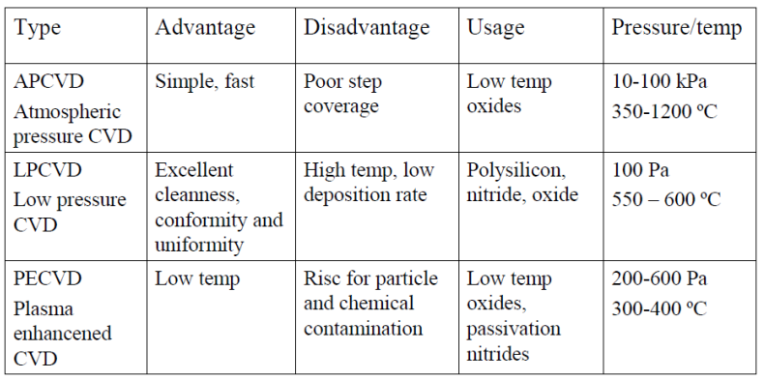
TYPES OF CVD

Slide 13
Atmospheric Pressure Chemical Vapour Deposition (APCVD)
APCVD is a thin film deposition process with typically high deposition rates.
A CVD method at normal pressure (atmospheric pressure), which is used for deposition of different oxides.
It uses atmospheric pressure or 1 atm in the reaction chamber.
APCVD is compatible with vacuum free, continuous in-line processes, making it very attractive for cost sensitive, high volume manufacturing applications like PV cell manufacturing.

Slide 14
APCVD
Atmospheric pressure systems (APCVD) have major drawbacks:
At high T, a horizontal configuration must be used (few wafers at a time).
At low T, the deposition rate goes down and throughput is again low.
The fundamental reason for the low throughput of APCVD is that only a small percentage of the gas is reactant gases, with the rest carrier/diluent gas

Slide 15
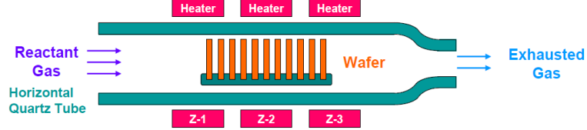
LOW PREASURE CVD

Slide 16
LOW PREASURE CVD
LPCVD is the first and most widely used deposition method used in solar cell processing. Due to its wide usage in semiconductor industry for a similar application.
LPCVD refers to a thermal process used to deposit thin films from gas-phase precursors at sub atmospheric pressures.
Process conditions are typically selected so that the growth rate is limited by the rate of the surface reaction, which is temperature-dependent. The temperature can be controlled with great precision, resulting in excellent within-wafer, wafer-to-wafer, and run-to-run uniformities.
LPCVD reactors use: P = 0.25 – 2.0Torr, T = 500 – 900°C.

Slide 17
LPCVD
Transport of reactants from gas phase to surface through boundary layer is still not rate limiting (despite the high T), so wafers can be stacked vertically for high throughput (100-200 wafers per run).
Because LPCVD operates in reaction limited regime, it is VERY sensitive to temperature and so temperature needs to be controlled closely (within +/- 1 oC), so use hot walled reactor for this precise control.
Again, a 5-25ºC temperature gradient is often created to offset source gas depletion effects (or one can use distributed feeding).
Requires no carrier gas, and low gas pressure reduces gas-phase reaction which causes particle cluster that contaminants the wafer and system.
Notes:
Torr is a unit of pressure. 1 Torr ≈ pressure of 1 mm of mercury (mmHg). Normal atmospheric pressure = 760 Torr.

Slide 18
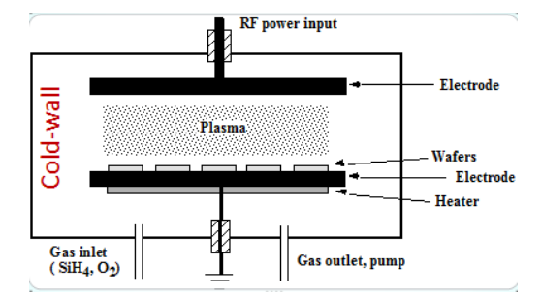
Plasma-enhanced chemical vapor deposition (PECVD)

Slide 19
PECVD
Plasma-enhanced chemical vapor deposition (PECVD) is a chemical vapor deposition process used to deposit thin films from a gas state (vapor) to a solid state on a substrate.
Chemical reactions are involved in the process, which occur after creation of a plasma of the reacting gases.
The plasma is generally created by radio frequency (RF) (alternating current (AC)) frequency or direct current (DC) discharge between two electrodes, the space between which is filled with the reacting gases.
A plasma is any gas in which a significant percentage of the atoms or molecules are ionized. The electrons can be maintained at very high equivalent temperatures – tens of thousands of kelvins, equivalent to several electronvolts average energy

Slide 20
PECVD
“Good” quality films (though generally not as good as LP or APCVD films deposited at much higher T): energy supplied by plasma (i.e. ion bombardment of film) increases film density, composition, and step coverage.
Use RF-induced plasma to transfer energy into the reactant gases, forming radicals that is very reactive. (RF: radio-frequency, typically 13.56MHz for PECVD)
Low temperature process (<300ºC), as thermal energy is less critical when RF energy exists.
Used for depositing film on metals (Al…) and other materials that cannot sustain high temperatures.
Surface reaction limited deposition, thus substrate temperature control is important to ensure uniformity.

Slide 21
PECVD
At low T, surface diffusion is slow, so one must supply kinetic energy for surface diffusion – plasma (ion bombardment) provides that energy and enhances step coverage.
Disadvantages: plasma damage, not pure film (often lots of H incorporated into film).

